Slide 1


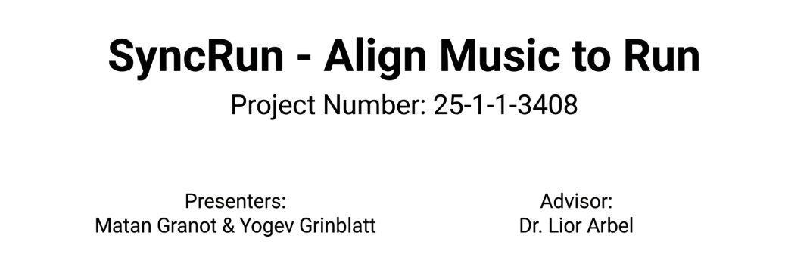

Slide 2
Project Overview
•SyncRun dynamically adjusts the playback rate of a rhythmic music track to seamlessly match a runner's offline step rhythm.
•It uses advanced time-stretch algorithms to synchronize musical beats with physical steps in real-time, without altering the original pitch.

Slide 3
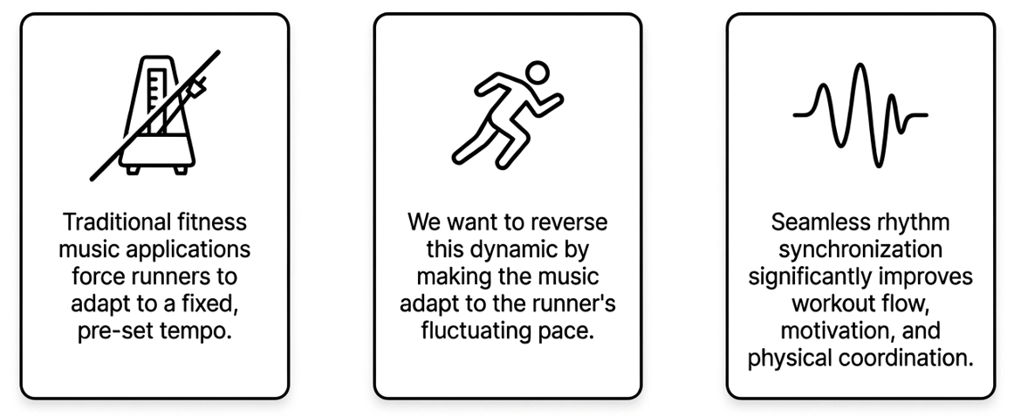
Motivation

Slide 4
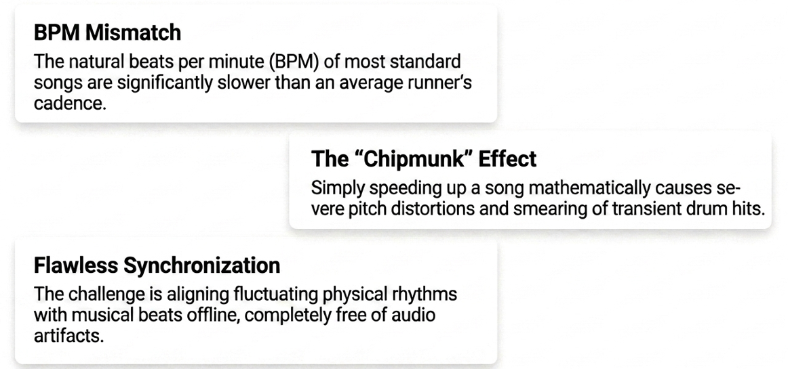
Problems

Slide 5
Block Diagram

Slide 6
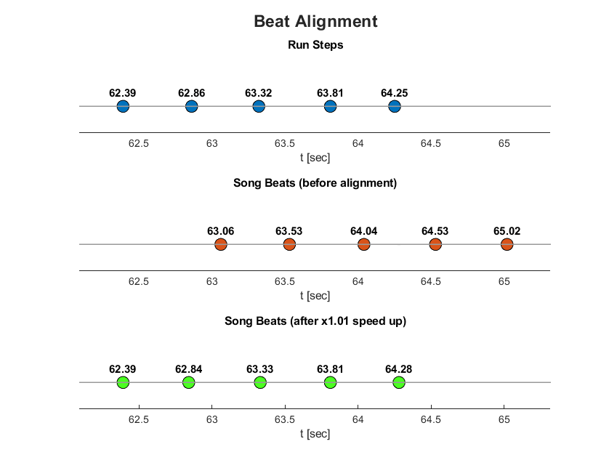
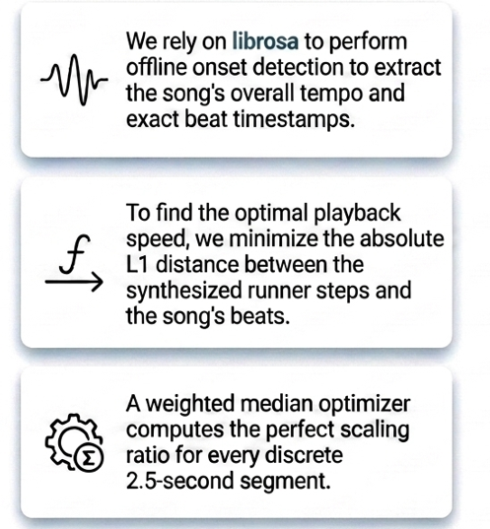
Click Generation & Alignment

Slide 7
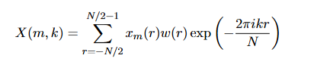
Step 1: Short-Time Fourier Transform (STFT)
The audio is first transformed from the time domain into the frequency domain. We utilize a window size of 2048 samples with a 75% overlap to ensure smooth reconstruction and phase coherence.

Slide 8
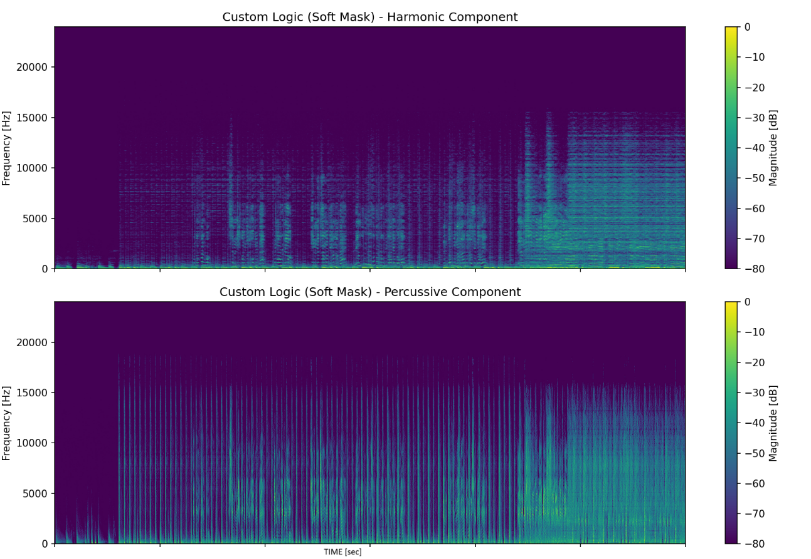
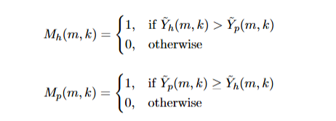
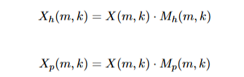
Step 2: Harmonic – Percussive separate (HPS)
We applied median filters to separate the original audio into its sustained, pitched sounds (harmonic content) and sharp, transient drum hits (percussive content)
And created binary masks are applied pointwise to the original complex STFT X(m,k) to isolate the complex frequency representations of each component

Slide 9
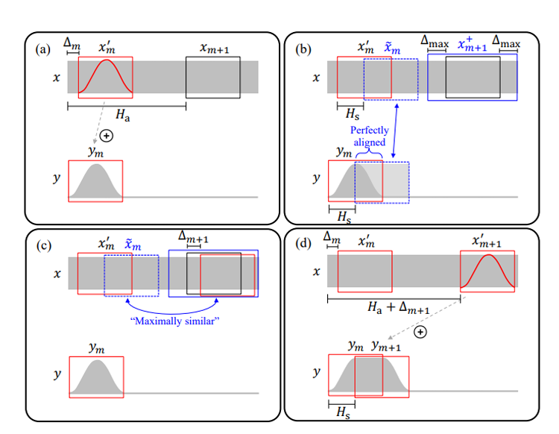
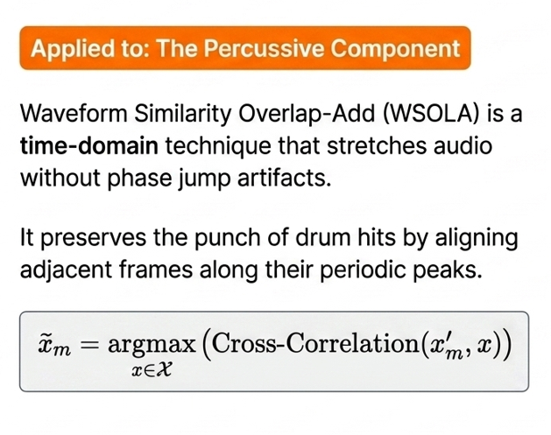
Step 3: WSOLA

Slide 10
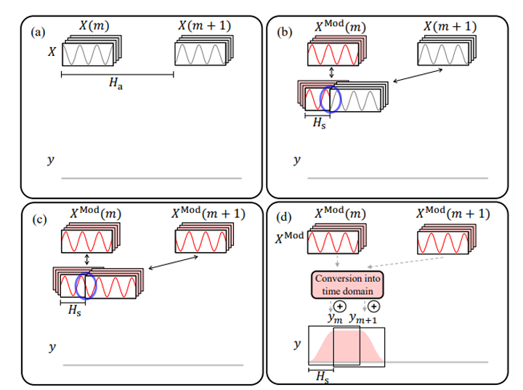
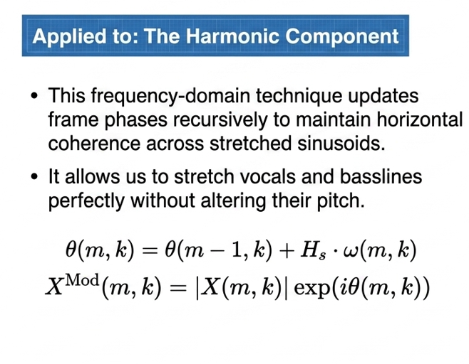
Step 4 : Phase Vocoder

Slide 11
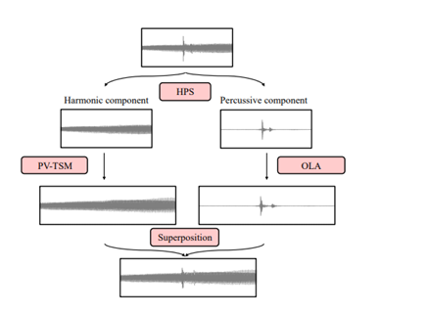
Step 5 : ISTFT & Reconstruction
The modified harmonic and percussive matrices are inverted back to the time domain.
The algorithm dynamically trims all components to the exact same minimum length.
The tracks are aggregated via superposition into a single, synchronized, output song.

Slide 12
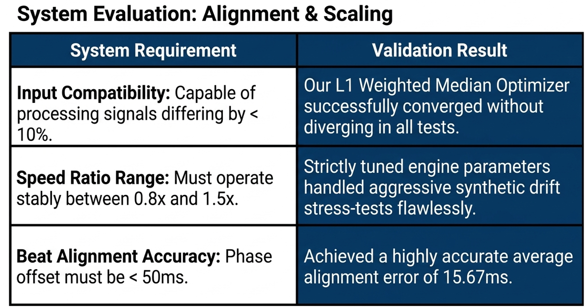

Slide 13
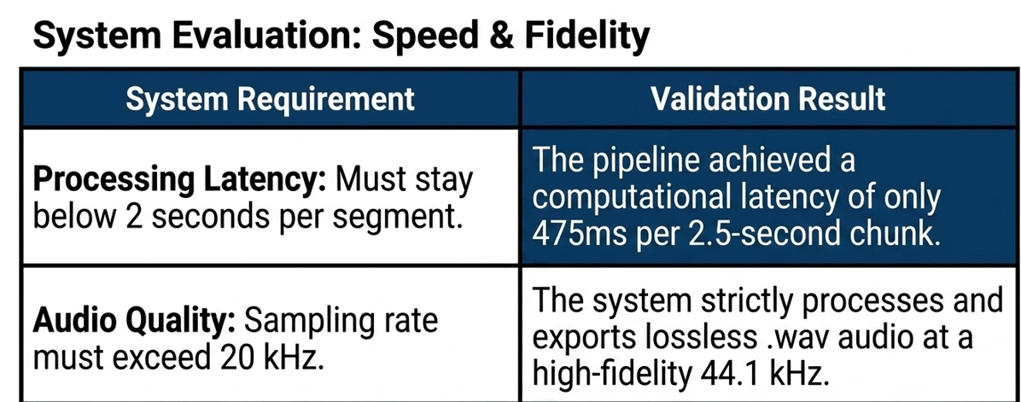

Slide 14
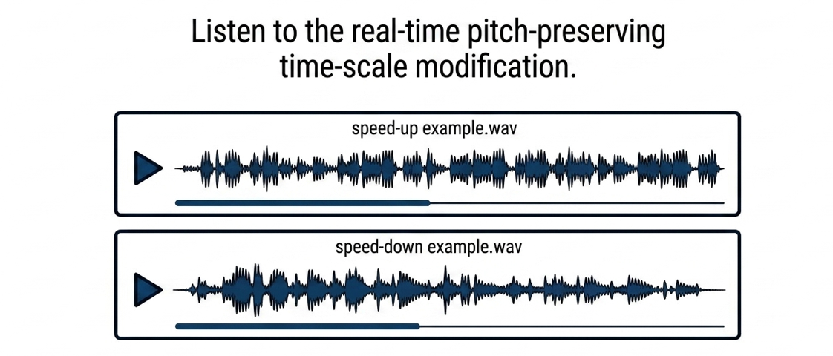


Slide 15
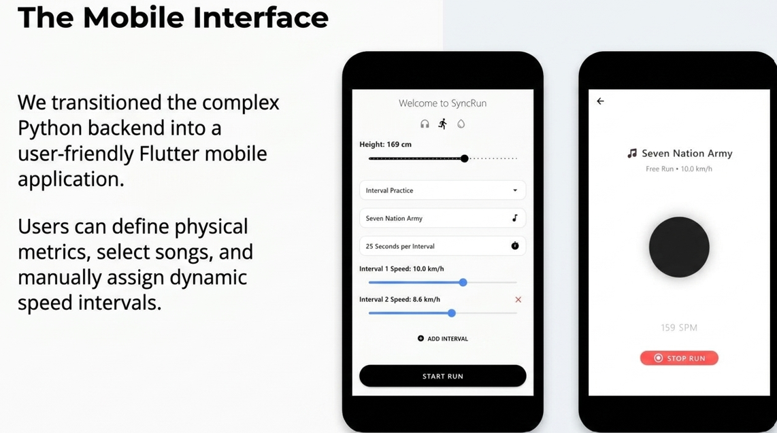

Slide 16
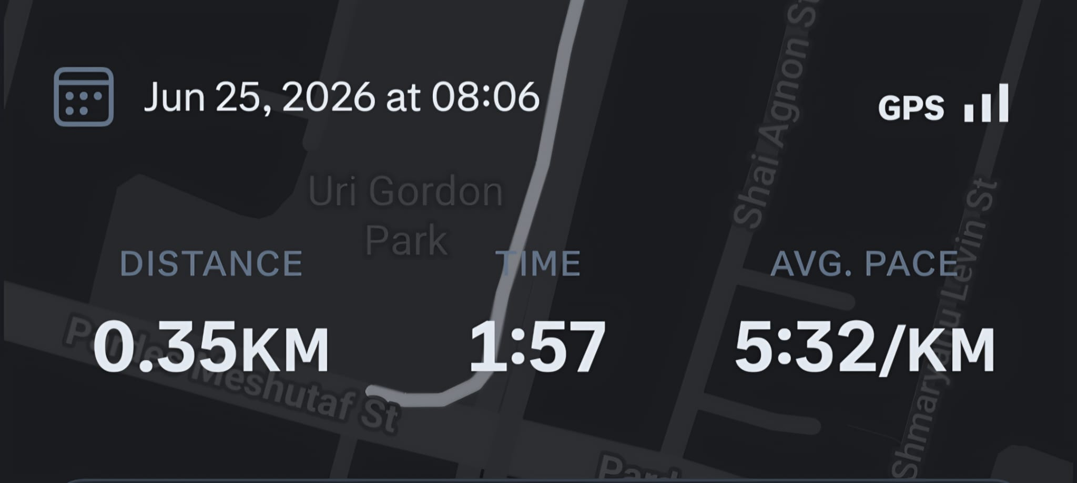
Field Testing The App
We transitioned from synthetic stochastic models to live field testing.
Example for 165 cm running in 11 km\h

Slide 17
Future Work
Transition to real-time, adaptive tempo adjustments using live biometric feedback from smartwatches, accelerometers, and barometers.
Shift processing directly to the mobile device and integrate with commercial platforms like Spotify to synchronize personalized playlists on the fly.

Slide 18


